Slide 1


Department of Artificial Intelligence and Data Science
Energy theft & anomaly detection
Dr. Suresh Kumar S
Professor, AI&DS dept.
Karthikeyan S 231801081
Keerthna S 231801083
Gopica H 231801043

Slide 2
Problem Statement and Motivation
Problem Statement
Electricity theft causes major financial losses to power distribution companies and affects fair energy usage. Detecting such theft manually is time-consuming and inefficient. This project aims to automatically identify abnormal power consumption patterns using big data analytics on the Google Cloud Platform.
Motivation
With the rapid increase in smart meter installations, huge amounts of data are generated every second. Leveraging cloud-based big data tools enables real-time detection of energy theft, reducing losses, improving grid efficiency, and ensuring fair billing for all consumers.

Slide 3
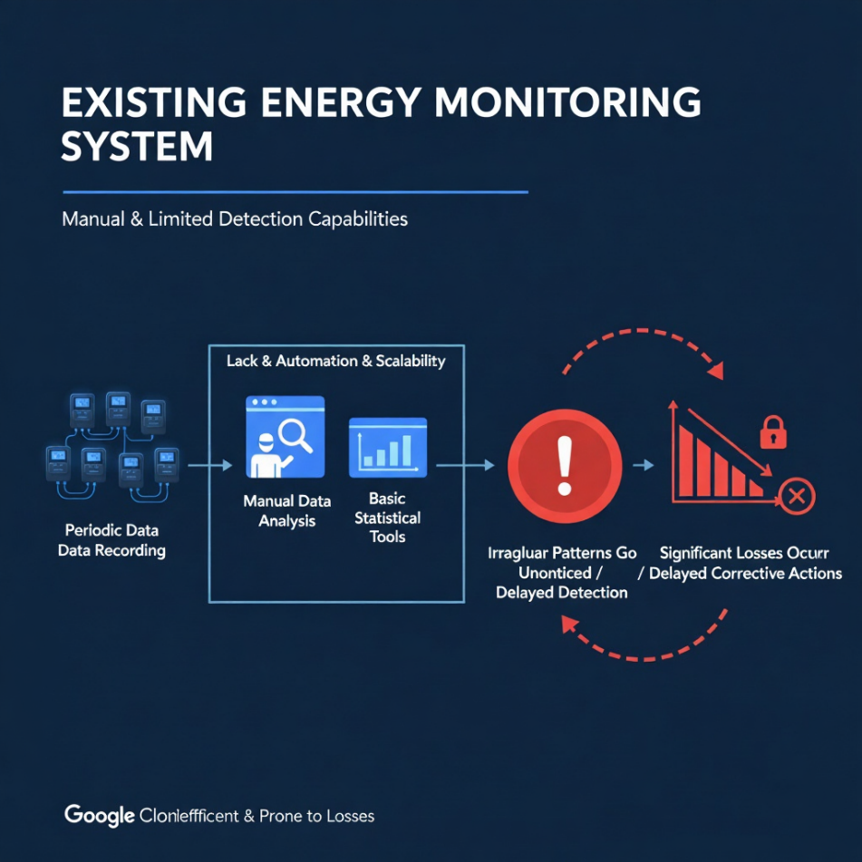
Existing System
In the existing energy monitoring systems, electricity usage is recorded periodically and analyzed manually or through basic statistical tools. These systems lack automation and scalability, making it difficult to detect irregular consumption patterns in real time. As a result, energy theft often goes unnoticed until significant losses occur, and corrective actions are delayed.

Slide 4
Objectives
To develop an automated system that detects electricity theft using machine learning techniques.
To process and analyze large volumes of meter data efficiently using Google Cloud Platform (GCP) services.
To identify abnormal energy consumption patterns in real time.
To visualize results for better decision-making and monitoring.

Slide 5
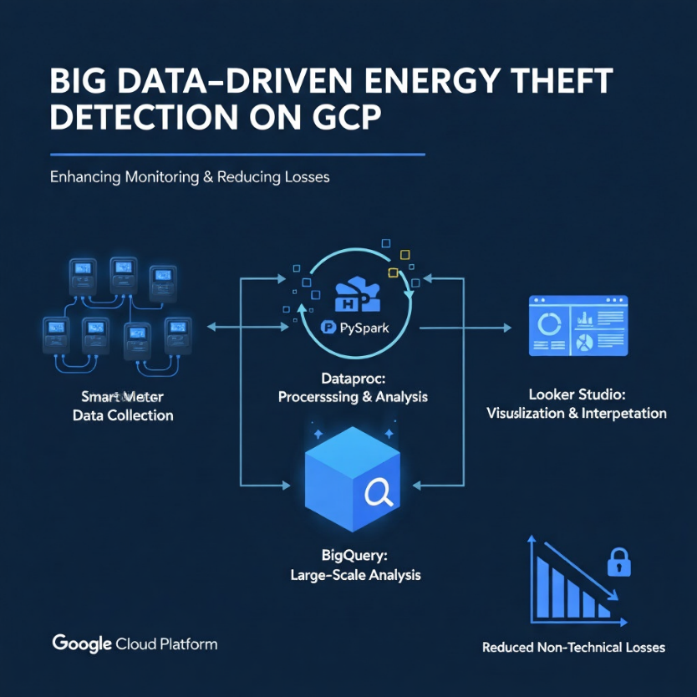
Abstract
Energy theft has become one of the most pressing issues in the power distribution sector, causing huge economic losses and operational inefficiencies for utility companies. Traditional monitoring systems often fail to detect such theft due to their limited analytical capabilities. This project presents a Big Data–driven approach for detecting anomalies in electricity usage using the Google Cloud Platform (GCP). Smart meter data is collected, preprocessed, and analyzed using Hadoop and PySpark on Dataproc to identify irregular consumption patterns that may indicate fraudulent activity. The processed data is stored in BigQuery for large-scale analysis, while visualization dashboards in Looker Studio enable easy interpretation of results. This system demonstrates how scalable cloud-based analytics can enhance energy monitoring, improve reliability, and significantly reduce non-technical power losses.

Slide 6
Thank You

